Slide 1
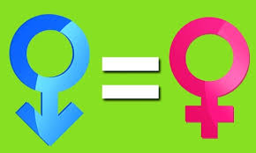
Gender Equality – Men Advocating Real Changes
This is what I commit to do differently :
I commit to become a more inclusive leader and actively seek support and engage every Women and Men in F&HC or EIMEA Engineering to move forward on the gender equality journey.
I will respect the choice of how much one wants to engage on this journey and respect where each of us stand on the gender equality awareness journey. Yet, I do have gender equality minimum expectations for my teams : - at least 50% female recruiting; - address inappropriate ‘gender-biased’ behaviors that I see or people make me aware of; - intentionally check for ‘gender unconscious bias‘ in staffing & talent management reviews.
I commit to be a more approachable leader to every Women and Men in F&HC or EIMEA Engineering and especially to engage with genuine care in dialogues in my teams to identify gender-related hurdles. My intent is to remove barriers and accelerate contributions, growth and unleash the true full potential of all of us.
I commit to be conscious of ‘privileges’ Men have and work to honorably leverage these to support at work others who don’t have these.
P. Ricci – June 2018

